Slide 1
Welcome Y’all!
City of Bruceville-eddy
council meeting 8/25/2022

Slide 2
Call to order

Slide 3
Citizen presentations

Slide 4
Approval of minutes

Slide 5
Staff reports
Police Chief – Michael Dorsey
Public Works Director – Gene Sprouse
City Engineer – Johnny Tabor
Code Enforcement Officer – Thomas Arnold

Slide 6
City engineer’s report
1. USDA Rural Development – New Wastewater System:
Tabor & Associates, Inc. is waiting on the remaining items required of the City before USDA Rural Development issues closing instructions and authorizes the project to be bid.
2. Hydraulic Analysis & System Mapping Update:
We delivered a final review set of system maps on August 23rd and visited with Gene about verifying the final positioning for some of the meters. We anticipate presenting to the City a final presentation of the Hydraulic Analysis and System Mapping at a meeting in October (recommend a Called Meeting due to the length of time for presentation and questions).
3. Foster Branch Addition – Lots 1 – 6 Water Improvements:
Construction contracts and Notice to Proceed were issued to Bull-G Construction at a Pre-Construction Conference held on August 23rd. The construction start date is September 2, 2022, and completion date is December 1, 2022. The Developer has cleared vegetation from the water line easement. The Developer will set stakes for water meter locations.

Slide 7
City administrator’s report
Council Audio/Visual System
Sewer Update
Hydraulic Analysis Study Update
Signage Around Town
November Election Update

Slide 8
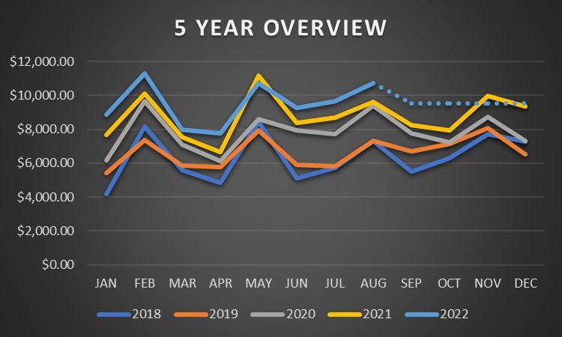
Sales Tax Revenue

Slide 9
Citizen Request for information

Slide 10
Updates to code of ordinances
Proactively prepares community for anticipated growth
Brings code of ordinances into alignment with industry standards
Focus of upgrades is on safer, more energy efficient buildings
Auto-adoption of future codes saves time and automatically keeps us up to date with these standards going forward – Codes published every 3 years
Not retroactive, affects future permits
- Staff Recommendation:
Approve as presented

Slide 11
Establishing the holiday schedule for 2023
- CA Recommendation:
Approve revised holiday schedule

Slide 12
Finances
Approval of finances
Acceptance of 2022 certified tax rolls
- Staff Recommendation:
Approve
- CA Recommendation:
Approve

Slide 13
Audit engagement
Same rates as last year
- Staff Recommendation:
Approve

Slide 14
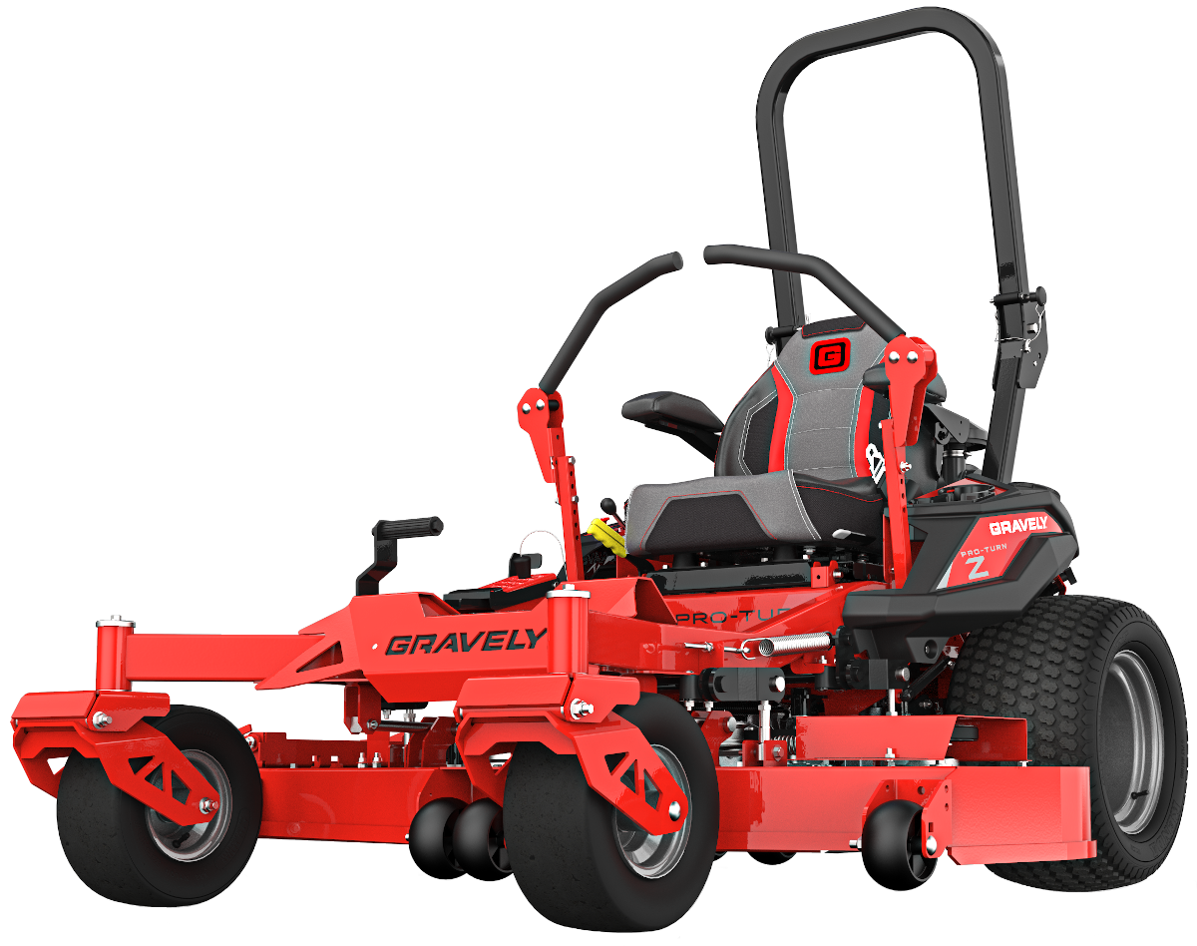
purchases
Mower
Meters
Current Kubota mower unreliable
Sale Kubota in FY 2022-2023, proceeds will offset the purchase cost
Purchase includes standard PM
Replacements are for commercial meters that must be hand read
Increased accuracy, will pay for themselves over a period of time
- Staff Recommendation:
Approve
- Staff Recommendation:
Approve, place all in service except for KCEN- TV location

Slide 15
purchases
Extended warranty
Factory warranty
$2433 – Quoted price at purchase
6 years or 100,000 miles
Reimbursement for a rental
Roadside Assistance
Void if a PM is missed, vehicle is modified (may include the 5th wheel hitch)
Basic Limited Warranty (Bumper-to-Bumper) 3 years/36,000 miles
Powertrain Limited Warranty 5 years/100,000 miles
The Anti-Corrosion Perforation Limited Warranty lasts 3-5 years/unlimited
The Federal Emissions Warranty lasts for 2 years/24,000 miles or 8 years/80,000 miles for specific components.
Roadside Assistance lasts for 5 years/60,000
- CA Recommendation:
Decline

Slide 16
Election of trustees
- CA Recommendation:
Make a motion to nominate a slate of candidates: Select one candidate for each seat on the board

Slide 17
Utility bill relief fund
Anonymous donor has contributed $1,000
We do not have any current rules or procedures in place to ensure the sound acceptance and distribution of these funds
Desired earmark is for senior citizens

Slide 18
Utility bill relief fund
New Ordinance
Accepting future unsolicited gifts
An application for potential recipients of funds and a review process for approval/denial
- CA Recommendation:
Make a motion to accept this initial donation, establish a separate bank account for these funds to be stored, and place a temporary spending hold on these funds until an ordinance can be approved by council at a future meeting
-

Slide 19
APPROVAL OF PROPOSED TAX RATE
The proposed tax rate would be lowered from $0.500000 to $0.460000 per $100 of valuation
This tax rate will raise more revenue than last year to the tune of $17,100, which is a 4.36% increase from last year’s budget. This increase is due to rising property value and the respective increases in appraisals determined by law, through both the McLennan and Falls County Appraisal districts.
This is not the final Tax Rate; this is an approval of the proposed tax rate.
A separate public hearing will take place on September 8th, 2022 at 6:00 p.m. where citizens are invited to make comments. Council will vote on the final tax rate after the public hearing.

Slide 20
Thank you for coming!
Download the savvy citizen app to stay informed!
Next meeting: September 8th, 2202 6:00 p.m.

